Slide 1
Generating 3D printable objects using Genetic Algorithms
Patrick Freel

Slide 2
What am I doing, no seriously
As the title implies
Notes:
Creating 3D printable objects from numbers

Slide 3
Genetic Solution
Yup, this made me realized I don’t have as much brain cells as I thinked I did

Slide 4
Setup
Each populations chromosome consists of:
List of Vertices: (-4.677, -1.153, -0.0), (0.116, 0.582, -0.982), (2.431, -1.678, -0.859)
List of Edges: (1, 14), (4, 14), (2, 19), (2, 14)
List of Faces: (0, 12, 8), (0, 8, 20), (1, 4, 14)
Generates between 100-500 chromosomes

Slide 5
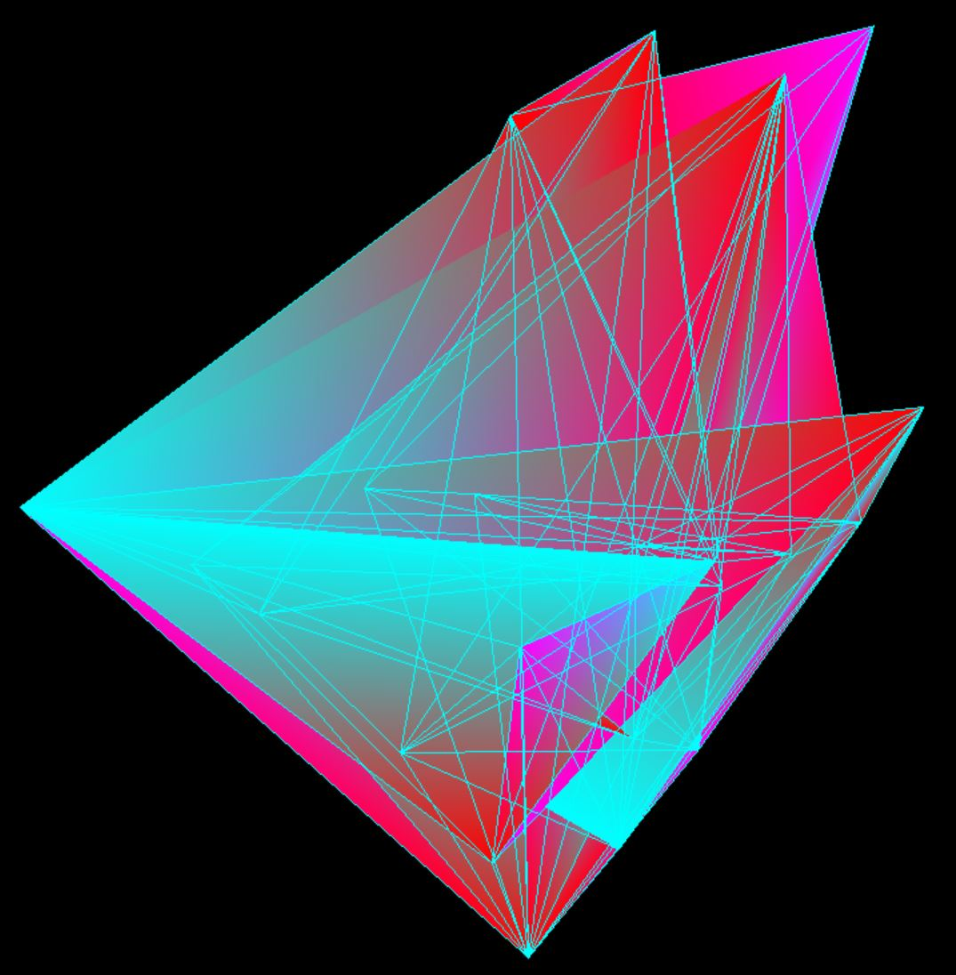
Notes:
Please ignore the 1998 graphics

Slide 6
Parent Selection
Two tournament selections
One of random tournament size
Another with a set tournament size of 10
Which used chosen at random
Notes:
Parent selection methods that require sorting couldn’t be used because the index positions of my vertices can NOT change

Slide 7
Fitness
Calculates the area of every face in each chromosome
round(abs(.5*((x1*y2 - x2*y1) + (x2*y3 - x3*y2) + (x3*y1 - x1*y3))), 3)
Notes:
Using the rounded, absolute value of… that. Thanks internet!

Slide 8
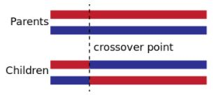
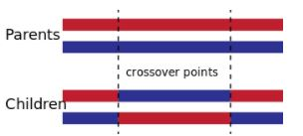
Crossover
Single-point and Double-point Crossover
Again selected at random
Notes:
It grabs the vertices from the faces index values from the chromosome at index and index plus one. Since each face has three positions the decision was made to randomize which vertices would be switched, however they always switch with their corresponding axis

Slide 9
Mutation
Testing threshold established
Score assigned to each vertex in chromosome
Notes:
1/L where L is the length of the population
If score < test: randomize the vertex position

Slide 10
Non-Genetic

Slide 11
Hill Climbing
Same setup as genetic
Uses same fitness function
Uses same mutation

Slide 12
What Happens
Generates Population
Gets fitness for each chromosome
Creates mutated Population
Gets fitness for each mutated chromosome
Compare each chromosomes fitness and append!

Slide 13
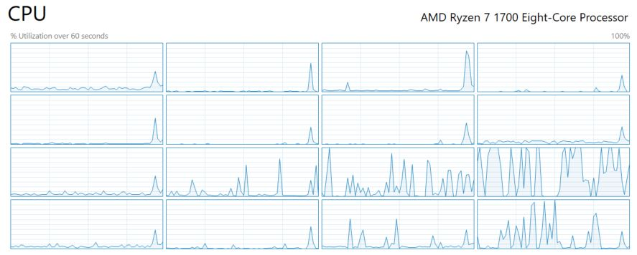
Future Works
Threading
Improve Fitness Function
Automatic Export for 3D Printing
Cloud
Notes:
Use all the threads
Provide a better fitness function that encourages distance between verts for a better 3D printing friendly object
Don’t have to manually find and copy/paste vast quantities of data
Compute on cloud, but expensive. 1 computer 1000 hrs, 1000 computers 1 hr

Slide 14
Demo

Slide 15
Questions

